Slide 1
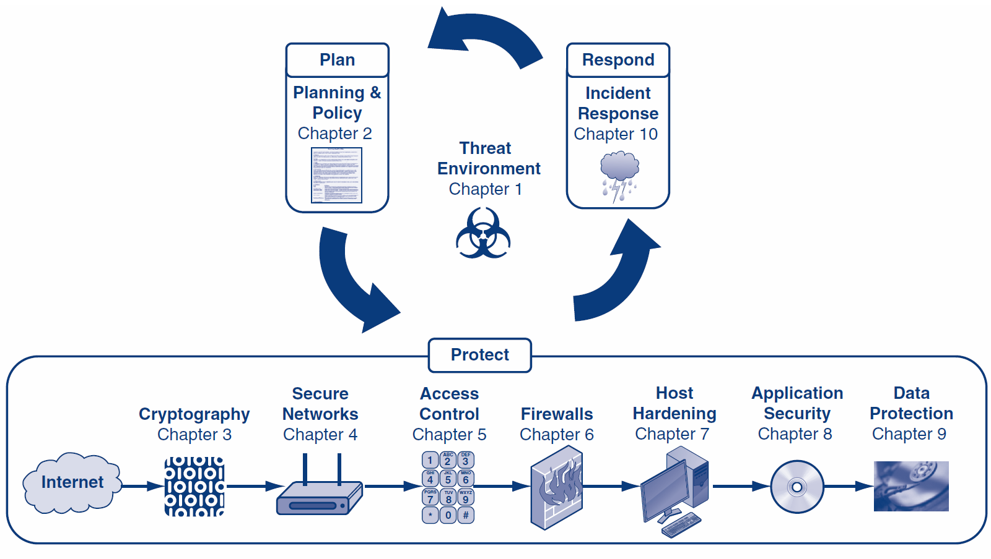
Course Text
Notes:
This course will follow the order of the course text, though some chapters will be given more focus than other chapters.

Slide 2
The Threat Environment
Corporate Computer Security, 4th Edition
Randall J. Boyle & Raymond R. Panko
Chapter 1

Slide 3
Content
Introduction & Terminology
Employees and Ex-employees Threats
Malware
Hackers and Attacks
Criminals
Competitor Threats
Cyberwar and Cyberterror

Slide 4
1-1: Basic Security Terminology
The Threat Environment
The threat environment consists of the types of attackers and attacks that companies face

Slide 5
1-1: Basic Security Terminology
Security Goals (CIA)
Confidentiality
Confidentiality means that unauthorized people cannot read sensitive information, either while it is on a computer or while it is traveling across a network

Slide 6
1-1: Basic Security Terminology
Security Goals
Integrity
Integrity means that attackers cannot change or destroy information, either while it is on a computer or while it is traveling across a network. Or, at least, if information is changed or destroyed, then the receiver can detect the change or restore destroyed data.

Slide 7
1-1: Basic Security Terminology
Security Goals
Availability
Availability means that people who are authorized to use information are not prevented from doing so

Slide 8
1-1: Basic Security Terminology
Vulnerability
Threats
Compromises
Successful attacks
Also called incidents or breaches
Notes:
A vulnerability is a weakness in the system.
A threat is the harm or loss that could happen to a system. Interception, interruption, modification, and fabrication are examples of threats.
An attack is the exploitation of a vulnerability to execute a threat

Slide 9
1-1: Basic Security Terminology
Countermeasures
Tools used to thwart attacks
Also called safeguards, protections, and controls
Types of countermeasures
Preventative
Deterring
Deflective
Detective
Corrective

Slide 10
1.1: The Sony Data Breaches
Sony Corporation
Japanese multinational corporation founded in 1946 that focuses on electronics, games, entertainment, and financial services
Employs about 146,300 people and has annual revenues of about $72.3 billion
Sony is widely known for its televisions, digital imaging, audio/video hardware, PCs, semiconductors, electronic components, and gaming platform.

Slide 11
1.1: The Sony Data Breaches
The First Attack
April 17-19, 2011
Attacks happened a few weeks after the large earthquake, tsunami, and reactor meltdowns
Used SQL injection to steal 77 million accounts
Turned off access to PlayStation Network (PSN)
Publicly acknowledges intrusion a week after the intrusion, on April 26th
CEO, Kazuo Hirai, issues public apology
Hacking group “Anonymous” is suspected

Slide 12
1.1: The Sony Data Breaches
The Second Attack
May 1st, 2011 – Sony Online Entertainment
Similar SQL injection attack used to steal additional 24.6 million accounts
Turned off access to all Sony Online Entertainment servers
CEO, Kazuo Hirai, issues written response to US Congress (May 4th) about steps to prevent future attacks
Some PSN services start to come online on May 15th

Slide 13
1.1: The Sony Data Breaches
The Third Attack
June 2nd, 2011 – SonyPictures.com
Similar SQL injection attack used to steal additional 1 million accounts
SonyPictures.com is immediately shut down
Hacking group LulzSec claims responsibility and issues press statement

Slide 14
1.1: The Sony Data Breaches
“Greetings folks. We're LulzSec, and welcome to Sownage. Enclosed you will find various collections of data stolen from internal Sony networks and websites, all of which we accessed easily and without the need for outside support or money.
We recently broke into SonyPictures.com and compromised over 1,000,000 users' personal information, including passwords, email addresses, home addresses, dates of birth, and all Sony opt-in data associated with their accounts. Among other things, we also compromised all admin details of Sony Pictures (including passwords) along with 75,000 ‘music codes’ and 3.5 million ‘music coupons’.”

Slide 15
1.1: The Sony Data Breaches
SQL injection is an attack that involves sending modified SQL statements to a web application that will, in turn, modify a database.
Attackers can send unexpected input through their web browser which will enable them to read from, write to, and even delete entire databases.

Slide 16
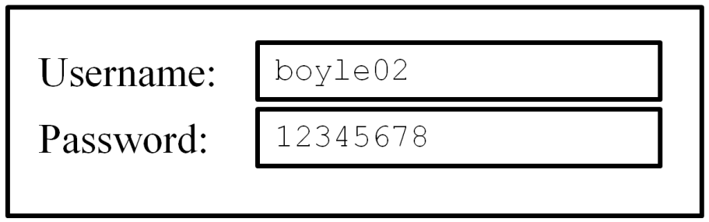
1.1: The Sony Data Breaches
SQL statement below shows parameters passed to a database for a legitimate login
SELECT FROM Users WHERE username=‘boyle02’ AND password=‘12345678’;

Slide 17
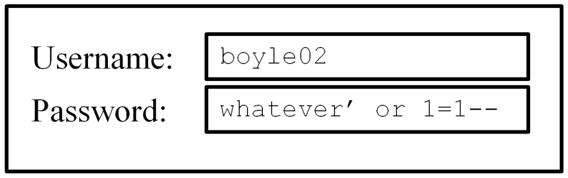
1.1: The Sony Data Breaches
Malformed SQL statement below shows SQL injection by passing unexpected parameters through a Web interface
Will always return a true value
SELECT FROM Users WHERE username=‘boyle02’ AND password=‘whatever’ or 1=1--’;

Slide 18
1.1: The Sony Data Breaches
The attackers
Members of both LulzSec and Anonymous are involved
Just before attacks on Sony, Anonymous announced the launch of operation “#OpSony” for lawsuits against George Hotz
George Hotz was being sued by Sony for jailbreaking PlayStation 3
Cody Kretsinger was arrested on Sept. 22, 2011 and pled guilty for his involvement in the Sony attacks
Hector Monsegur, facing 122 years in prison, was key informant who identified other attackers

Slide 19
1.1: The Sony Data Breaches
The Fall-Out: Lawsuits and Investigations
Sony offered 1 year of free identify theft services, month of free gaming, and a few free games from a limited selection
To date, no known credit fraud directly tied to the Sony data breaches
Fined $395,000 by UK because “security measures were simply not good enough”
Sony estimates losses at $171 million
Difficult to estimate damage to Sony’s reputation

Slide 20
1.2: Employee and Ex-Employee Threats
Employees and Ex-Employees Are Dangerous
Dangerous because
They have knowledge of internal systems
They often have the permissions to access systems
They often know how to avoid detection
Employees generally are trusted
IT and especially IT security professionals are the greatest employee threats

Slide 21
1.2: Employee and Ex-Employee Threats
Employee Sabotage
Destruction of hardware, software, or data
Plant time bomb or logic bomb on computer
Employee Hacking
Hacking is intentionally accessing a computer resource without authorization or in excess of authorization
Authorization is the key

Slide 22
1.2: Employee and Ex-Employee Threats
Employee Financial Theft
Misappropriation of assets
Theft of money
Employee Theft of Intellectual Property (IP)
Copyrights and patents (formally protected)
Trade secrets: plans, product formulations, business processes, and other info that a company wishes to keep secret from competitors

Slide 23
1.2: Employee and Ex-Employee Threats
Employee Extortion
Perpetrator tries to obtain money or other goods by threatening to take actions that would be against the victim’s interest
Sexual or Racial Harassment of Other Employees
Via e-mail
Displaying pornographic material
…

Slide 24
1.2: Employee and Ex-Employee Threats
Internet Abuse
Downloading pornography, which can lead to sexual harassment lawsuits and viruses
Downloading pirated software, music, and video, which can lead to copyright violation penalties
Excessive personal use of the Internet at work

Slide 25
1.2: Employee and Ex-Employee Threats
Carelessness
Loss of computers or data media containing sensitive information
Careless leading to the theft of such information
Other “Internal” Attackers
Contract workers
Workers in contracting companies

Slide 26

Copy Right Warning
All rights reserved. No part of this publication may be reproduced, stored in a retrieval system, or transmitted, in any form or by any means, electronic, mechanical, photocopying, recording, or otherwise, without the prior written permission of the publisher. Printed in the United States of America.
Copyright © 2015 Pearson Education, Inc.

